Slide 1




Predicting Bed Allocation Time During Crisis
Health Care2: Predictive Analytics for Patient Admissions
Members:
Shiladitya Sarkar (2348556)
Swapnali Singh (2348565)

Slide 2
INTRODUCTION
AIM: To Develop a Hospital Bed and Recovery Time Recommender System that helps hospitals efficiently manage bed availability and provide patients with accurate recovery time estimates based on historical data.
Key Features:
Real-time Bed Availability: Patients and healthcare staff can view real-time updates on bed availability, ensuring efficient bed allocation, especially during crises.
First-Come, First-Served Allocation: In normal situations, beds are allocated on a first-come, first-served basis, while special conditions like surgeries or emergencies follow a different protocol.

Slide 3
Problem Statement: Efficient Bed Management and Patient Recovery Time Prediction System
Background:
In healthcare settings, managing bed availability and patient recovery efficiently is crucial.
Accurate prediction of bed availability and patient recovery times helps in optimizing resource allocation and improving patient care.
Challenges:
Bed Availability Prediction:
Difficulty in predicting when a bed will become available based on current and historical data.
Bed Allocation:
Ensuring fair bed allocation based on patient condition and booking time, with a first-come, first-served approach for non-emergency cases.

Slide 4
ABOUT DATASET
P_ID: Unique 7-digit ID starting with the digit 7, allotted to each patient for identification.
P_Age: Patient ages, ranging between 10 and 60 years.
Gender: The gender of the patient, recorded as either Male or Female.
Bed_No: Unique bed number assigned to each patient, ranging between 1 and 500.
Pre-existing Conditions: Information on any prior medical conditions or history that the patient has.
Condition Severity: The severity of the patient’s condition, categorized as Mild, Moderate, or Severe.
Disease type: Classification of the disease type, whether it is Highly communicable, ICU-related, or Normal.
Admission_ID: A unique identifier for each admission, which includes both numbers and alphabets.
Admission_Date: The date when the patient was admitted and the bed was allocated.
Admission_Type: Specifies the nature of the admission, such as emergency or scheduled.
Department: The department in which the patient is being treated, such as General Surgery, Neurology, or Cardiology.
Treatment_Start_Date: The date when the patient’s treatment begins, which occurs after bed allocation (between 2020-2023).
Treatment_End_Date: The date when the patient’s treatment ends, varying based on disease type.
Bed_Allocation_Date: The date when the bed was allocated to the patient, which is the same as the admission date.
Bed_Release_Date: The date when the bed is vacated, corresponding with the treatment end date.
Recovery_Time: The number of days between bed allocation and release, indicating the total recovery duration.

Slide 5
Data Preparation
Data Generation:
Used Gretel.ai to generate synthetic patient data.
Generated multiple CSV files to simulate real-world scenarios.
Data Compilation:
Combined all CSV files into a unified dataset.
Resulted in a total of 1189 rows of data.
Dataset Overview:
Total Columns: 17 columns capturing various aspects of patient data.

Slide 6
Data Analysis
Dataset Overview:
Shape of the Data: 1189 rows and 8 columns (After Pre-Processing).
Variable Classification:
Integer-Categorical Variables: 3
String-Categorical Variables: 4
Boolean Variables: 1
Numeric Variables: 0
Date Time Columns: None

Slide 7
Duplicate Rows:
338 duplicate rows identified.
Removing duplicates might impact column data types.
Data Quality Issues:
Condition Severity:
missing values & Mixed data types (object and float).
Impute missing values with mean, median, mode, or a constant & making in same datatype.
Recovery Time:
75 outliers detected beyond expected range.
To remove outliers to improve data quality.
Variable Details:
Pre-existing Conditions: Ranges from 0 to 3 with no issues.
Gender, Disease Type, Admission Type, Department: No missing values and no issues detected.

Slide 8
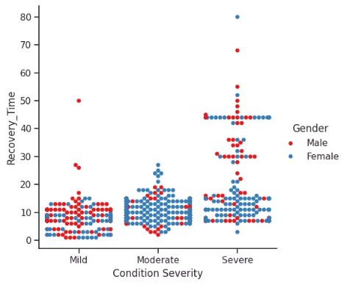
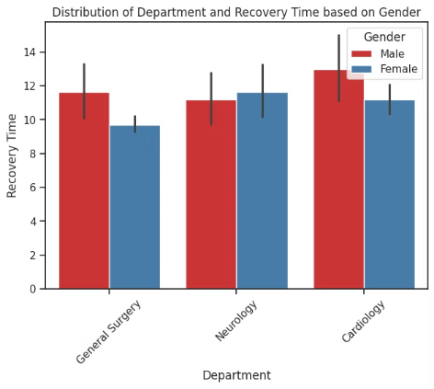
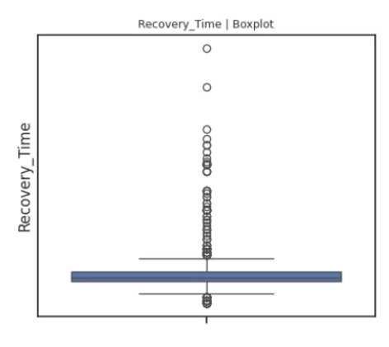
Visualization
CatPlot
Bar Plot
Box-Plot
Patient's condition severity and time it to recover with gender distribution
Distribution of Department and respective Recovery time based on gender distribution
Boxplot to see the distribution of recovery time of Patients & detecting outliers.

Slide 9
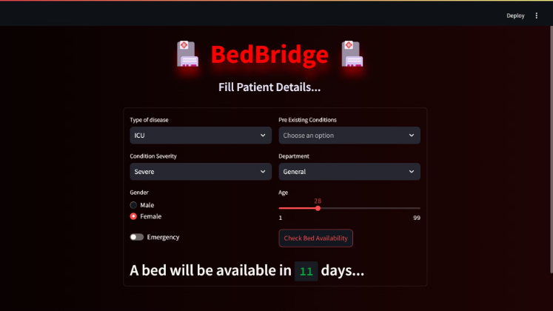
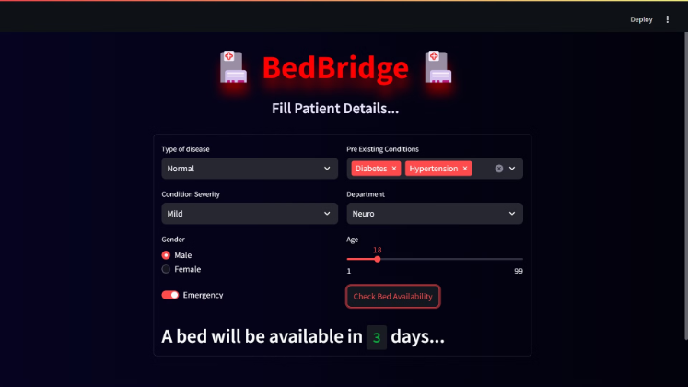
Recommendation
Utilized Streamlit to deploy the app.

Slide 10
Who can use this Analysis
Hospital Administrators: Improved resource management and optimized bed allocation.
Enhanced decision-making during crises and peak times.
Healthcare Providers: More efficient treatment planning with accurate recovery time predictions.
Reduced workload in managing bed availability and patient turnover.
Patients: Improved access to hospital beds with timely updates on availability.
Hospital Staff: Streamlined operations with automated bed management processes. Reduced manual tracking and administrative tasks related to bed allocation.
Health Insurance Providers: More accurate estimation of hospital stay durations, leading to better financial planning and coverage decisions.
Public Health Authorities: Better data for monitoring hospital capacity during emergencies or pandemics.

Slide 11
Reflection
Challenges Faced during project:
Data Preparation:
Challenges arose due to the lack of natural trends in synthetic data, making it difficult to capture real-world variability.
Data Preprocessing:
Handling inconsistencies: missing values, normalize data, and encode categorical variables to ensure data was ready for modeling.
Model Selection:
Utilized Linear Regression, Decision Tree, SVM, Random Forest, Gradient Boost & XGBoost to evaluate and find the best fit model for analysis
Privacy Issues:
The use of synthetic data helped mitigate privacy concerns, but transitioning to real-time data will require strict compliance with data privacy regulations.

Slide 12
Conclusion
The project- 'Bed Bridge' underscores the importance of incorporating real-time data for more accurate trend analysis and decision-making. Additionally, it highlights the need for robust computational resources and strong privacy protections. Moving forward, integrating real-world data and refining feature engineering will enhance the accuracy and effectiveness of Bed Bridge in hospital settings, improving patient care and resource management.

